Slide 1
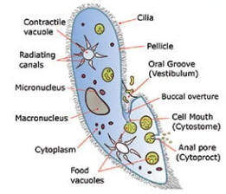
PROTOZOA

Slide 2
PROTOZOA
Protozoa are microscopic unicellular eukaryotes that have a relatively complex internal structure and carry out complex metabolic activities.
Protozoa are one-celled animals found worldwide in most habitats. Most species are free living, but all higher animals are infected with one or more species of protozoa.
Anton Van Leeuwenhoek was the first to observe protozoa (Vorticella convellaria) under a microscope. He called them animalcules.
Gold fuss coined the term Protozoa which in Greek means first animals (Proto= first; zoans=animals)

Slide 3
characteristics
There are about 50,000 known species of Phylum Protozoa.
Protozoans exhibit mainly two forms of life; free-living (aquatic, freshwater, seawater) and parasitic (ectoparasites or endoparasites). They are also commensal in habitat.
They are small, usually microscopic, not visualize without a microscope.
They are the simplest and primitive of all animals.
They have a simple body organization.

Slide 4
The body is unicellular (without tissue and organs).
They have one or more nuclei which are monomorphic or dimorphic.
Body naked or bounded by a pellicle, but in some forms may be covered with shells and often provided with an internal skeleton.
They are solitary (existing alone/single) or colonial.
Body shape variables may be spherical, oval, elongated or flattened.
Body symmetry either none or bilateral or radial or spherical.

Slide 5
Locomotory organs are fingers like pseudopodia, whip-like flagella, hair-like cilia or none.
Nutrition may be holozoic (animal-like), holophytic (plant-like), saprozoic or parasitic.
Reproduction asexual (binary or multiple fission, budding, sporulation) or sexual (conjugation (hologamy), gamete formation (syngamy)).
Examples: Euglena, Amoeba, Plasmodium, Paramecium, Podophyra, etc.

Slide 6
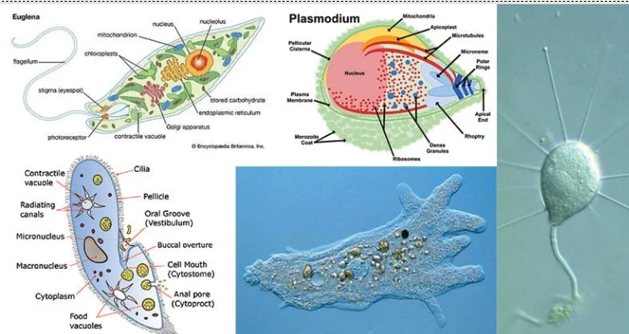

Slide 7
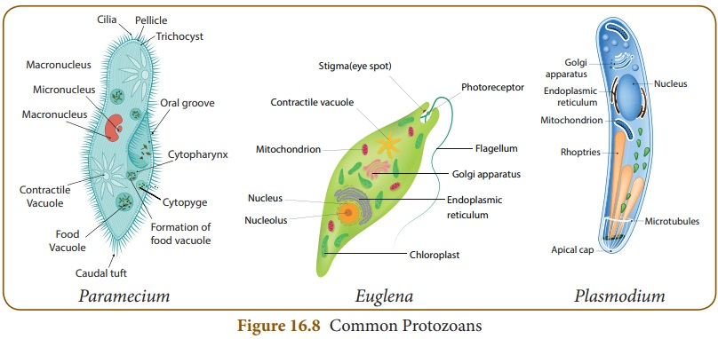

Slide 8
Structure
Protozoa are single-celled, eukaryotic organisms with a diverse structure, typically consisting of a nucleus, a cytoplasm divided into ectoplasm and endoplasm, and a plasma membrane.
They lack cell walls but some have a rigid external pellicle or a secreted shell.
Locomotion is achieved through projections like cilia, flagella, or pseudopodia.
Internal organelles such as mitochondria, food vacuoles, and contractile vacuoles are present, performing functions analogous to those of organs in higher animals.

Slide 9
General Structure
Cell Membrane: A plasma membrane encloses the entire cell and its projections.
Pellicle: Some protozoa possess a pellicle, a flexible, yet rigid, outer layer composed of microtubules, microfilaments, and plates that helps maintain a definite shape.
Cytoplasm: The cytoplasm is typically divided into an outer, clear ectoplasm and an inner endoplasm.
  Ectoplasm: Primarily involved in movement and respiration.
  Endoplasm: Contains most of the cell's organelles, including food vacuoles, lysosomes, and the nucleus.

Slide 10
Organelles and Inclusions
Nucleus: All protozoa have at least one membrane-bound nucleus containing DNA. Ciliates may have both a large, polyploid macronucleus and smaller micronuclei.
Contractile Vacuoles: These organelles regulate water balance by pumping excess water out of the cell, especially important in freshwater protozoa.
Food Vacuoles: Formed for the digestion of ingested food particles.
Mitochondria: Responsible for cellular respiration.
Lysosomes: Contain digestive enzymes.
Cytostome/Gullet: Some protozoa have a cell mouth (cytostome) or a gullet to ingest food particles.
Other Structures: Depending on the species, structures like trichocysts (for defense), undulating membranes, or a kinetoplast (a DNA-containing body in some flagellates) may be present.

Slide 11
Locomotory Structures
Pseudopodia: Temporary extensions of the cytoplasm used by amoebas for movement and feeding.
Cilia: Short, hair-like projections used for movement and feeding.
Flagella: Longer, whip-like appendages for locomotion.
Other Features
Cysts: Under adverse conditions, some protozoa can form a cyst, a protective resting stage that helps them survive until favorable conditions return.

Slide 12
Classification of Protozoa
Phylum Protozoa is a large and varied group.
Most accepted classification of protozoa is given by BM Honigberg and others based on the scheme given by the committee on Taxonomy and Taxonomic problems of the society of Protozoologists divides this phyla into 4 subphyla.

Slide 13
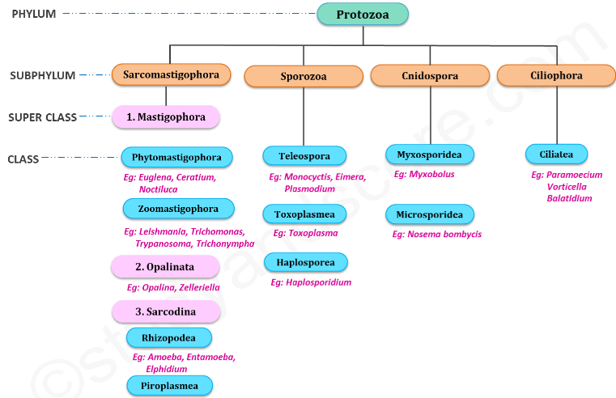


Slide 14
SUBPHYLUM I: SARCOMASTIGOPHORA
Sarcodes=fleshy; mastix=whip; phoros=bearing.
The locomotion in this subphylum is brought about by flagella or pseudopodia or both.
Other important feature of this subphylum is the presence of monomorphic nuclei.

Slide 15
SARCOMASTIGOPHORA subphylum is further divided in to 3 super classes:
Superclass 1: Mastigophora (Gr. Mastix=whip; phoros=bearing)
Superclass 2: Opalinata
Superclass 3: Sarcodina (Gr. Sarcode=fleshy)

Slide 16
Superclass 1: Mastigophora
this super class is covered by pellicle.
The locomotory organelles are flagella.
In this super class the asexual reproduction occurs by longitudinal binary fission.
This super class includes 2 classes:
Class 1: Phytomastigophora
Chlorophyll-bearing chromatophores present.
Nutrition mainly holophytic by phototrophy.
Reserve food is starch or paramylon.
They have usually only one or two flagella.
Ex: Euglena, Ceratium, Noctiluca

Slide 17
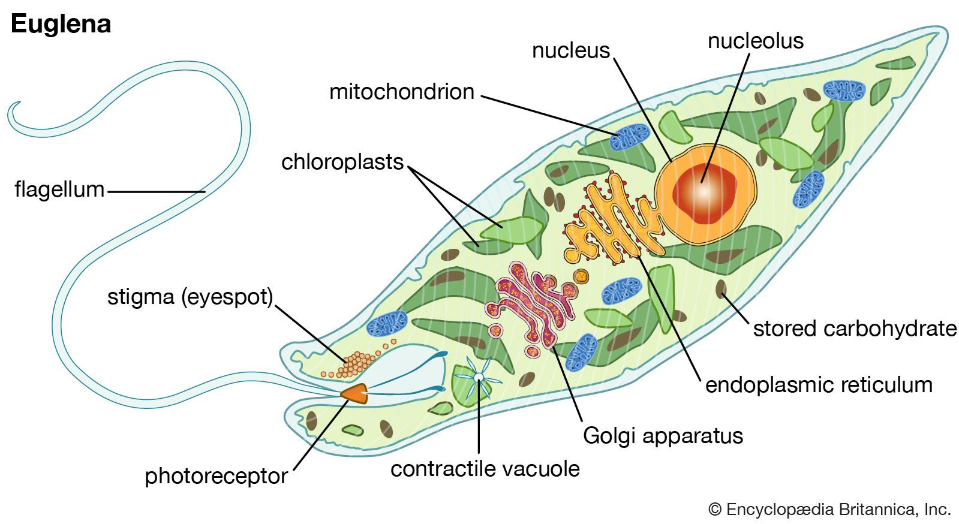
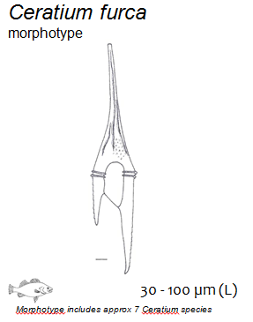

Slide 18
Class 2: Zoomastigophora (Gr. Zoon=animal; Mastix=whip; phoros=bearing)
These organisms do not have chlorophyll bearing chromatophores.
These are mostly parasitic. The nutrition in these organisms is holozoic or saprozoic.
The reserved food is glycogen.
They may have one to many flagella.
Ex: Leishmania, Trypanosoma, Trichomonas, Trichonympha

Slide 19
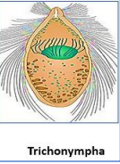
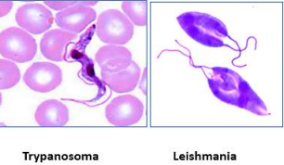

Slide 20
Superclass 2: Opalinata
They have numerous cilia like organelles in oblique rows over the entire body surface.
There is no cytostome.
Two or more monomorphic nuclei are present.
Binary fission is interkinetal.
There is syngamy with flagellated anisogametes.
All are parasitic, mainly in frogs and toads.
Examples: Opalina, Protoopalina, Zelleriella, Protozelleriella, and Cepedea

Slide 21


Slide 22
Superclass 3: Sarcodina
Locomotory organelles are pseudopodia.
The amoeboid form is predominant.
Some have a hard shell.
They generally do not form spores.
The formation of gametes and flagellated young ones are common.
Class 1: Rhizopodea
Locomotory organelles are pseudopodia
They are generally creeping forms.
Ex: Amoeba, Entamoeba, Elphidium

Slide 23
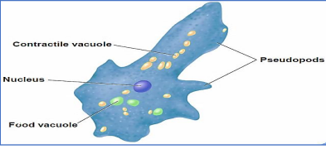

Slide 24
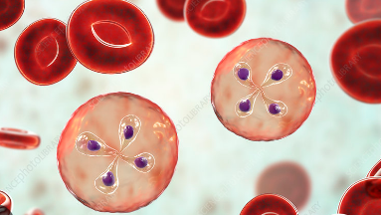
Class 2: Piroplasmea
The animals belonging to this class are parasitic.
Locomotory structures are absent in this class. Spores are also absent.
These are the small parasites in the red blood cells of vertebrates.
Ex: Babesia

Slide 25
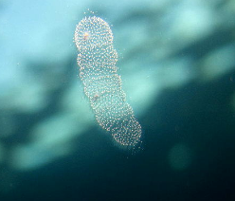
Class 3: Actinopodea
Pseudopodia mainly axopodia with axial filaments, radiating from a spherical body.
They are primarily sessile or floating forms.
Gametes are usually flagellated.
Reproduction is both sexual and asexual.
Ex: Collozoum, Actinophrys, Acanthometra

Slide 26
SUBPHYLUM II: SPOROZOA
Locomotory organelles absent.
Spores usually present.
Exclusively endoparasites.
Cilia or flagella may be present in gametes.
Syngamy takes place after which many spores are formed.
The spores are simple and contain one to many sporozoites.
The nucleus is of the single type.
This subphylum includes 3 classes:

Slide 27
Class 1: Telosporea
The Sporozoites are long in these animals.
Reproduction is both asexual and sexual.
They are blood and gut parasites of vertebrates.
Sexual reproduction is by isogamy or anisogamy.
Ex: Monocyctis, Eimera, Plasmodium

Slide 28
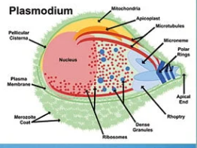

Slide 29
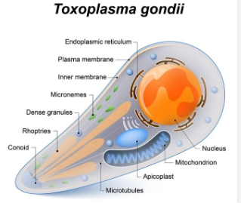
Class 2: Toxoplasmea
In this class reproduction is only asexual type which takes place by internal budding where two daughter cells are produced within the mother cell and the mother cell is finally destroyed in the process of reproduction. Spores are absent.
Ex: Toxoplasma

Slide 30
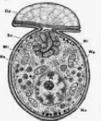
Class 3: Haplosporea
reproduction is only asexual type taking place through multiple fissions.
Ex: Haplosporidium, Ichthyosporidium

Slide 31
SUBPHYLUM III: CNIDOSPORA
this subphylum are parasitic.
Special kind of locomotory organelles are absent in these animals.
Spores are present with one or more polar filaments.
This subphylum includes 2 classes:

Slide 32
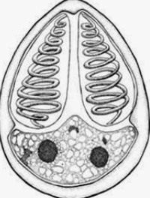
Class 1: Myxosporidea
The spores of the animals of this class are large and develop from several nuclei.
These are generally extracellular parasites.
The spores of this class have two polar filaments and have two to three valves
Ex: Myxobolus

Slide 33
Class 2: Microsporidea
The spores of the animals of this class are small and are developed from only one nucleus.
These are generally intracellular parasites.
Many of the animals of this class have a single polar filament.
Ex: Nosema bombycis

Slide 34
SUBPHYLUM IV: CILIOPHORA
Cilium=eye lid with lashes; phoros=bearing)
They possess simple ciliary organelles for locomotion.
They have two nuclei, a trophic macronucleus, and a reproductive micronucleus.
Binary fission is perkinetal.
Conjugation takes place with the fusion of nuclei, autogamy and cytogamy also occur.
There are never any free gametes.
Nutrition is mixotrophic or heterotrophic.
They usually have a cytostome.

Slide 35
Class 1: Ciliatea
The locomotory organelles of these animals are numerous hair-like cilia.
One or more contractile vacuoles are present in these forms
The nucleus is dimorphic including both macro nucleus and micronucleus.
Ex: Paramoecium, Vorticella, Balatidium

Slide 36
